Slide 1
UNIVERSITY INSTITUTE OF COMPUTING
Bachelors of Computer Applications/Science
Minor Project
22CAR-304
Made Setup
An Overview
of Computing
&
Career Planning
Student Name: Dhruv Jindal
UID: 22BCA10288
Section/Group: 22BCA-3 ‘A’
Supervisor Name: Ms Jasleen Kaur
Employee Code: E16528
Designation: Professor
Minor Project Presentation
DISCOVER . LEARN . EMPOWER

Slide 2
Introduction to Project
Welcome to Made Setup – Your Ultimate Destination for All Things Setup!
Whether you're a gamer, designer, or office professional, Made Setup offers a wide range of products tailored to meet your specific needs. From complete setup solutions to individual PC parts, our platform is designed to provide everything you need to build and enhance your perfect workspace.
Our mission is to simplify the process of creating an ideal setup, offering top-quality products, easy navigation, and expert recommendations, all in one place.

Slide 3
Technology Used
HTML5 & CSS3: For website structure and responsive design.
JavaScript: Adds interactivity and dynamic features.
PHP: Server-side processing and database interaction.
MySQL: Stores product, user, and order data.
Bootstrap: Ensures mobile-friendly, responsive design.
SwiperJS: Product carousels and image sliders.
APIs: Integrations for Google Maps, payment gateways, and delivery services.

Slide 4
Objectives
Streamline Shopping:
Provide a unified platform for purchasing setup-related products and PC parts.
Enhance User Experience:
Offer tailored recommendations and easy navigation for specific needs (gaming, design, office).
Ensure Quality:
Curate high-quality products to ensure compatibility and reliability.
Simplify Decision-Making:
Help users make informed choices with expert guidance and curated selections.

Slide 5
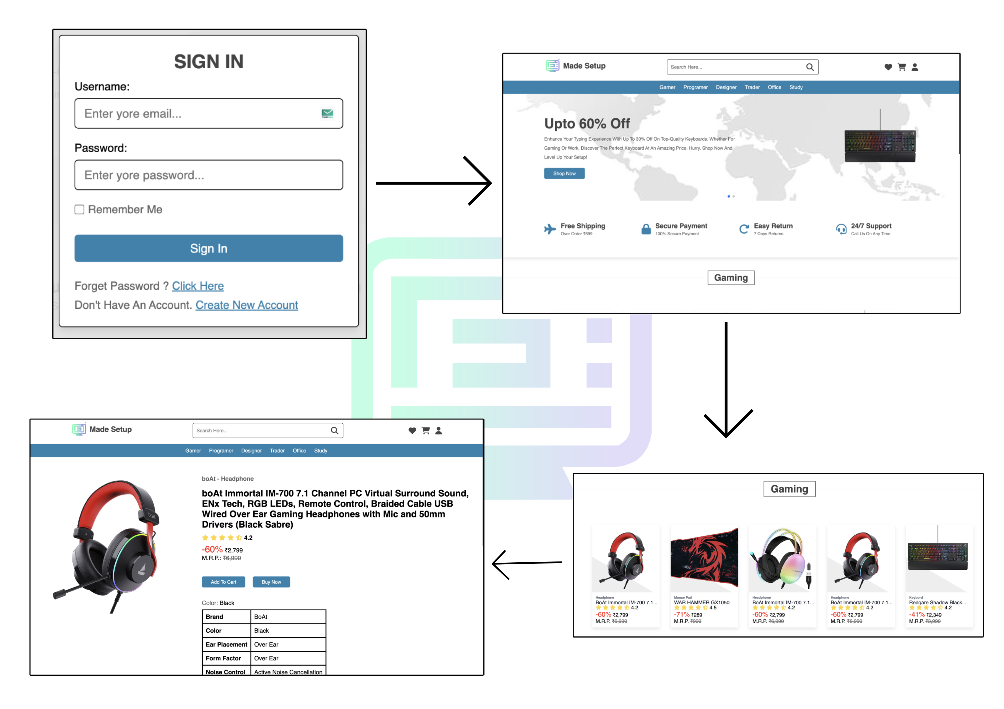
Project Flow Diagram

Slide 6
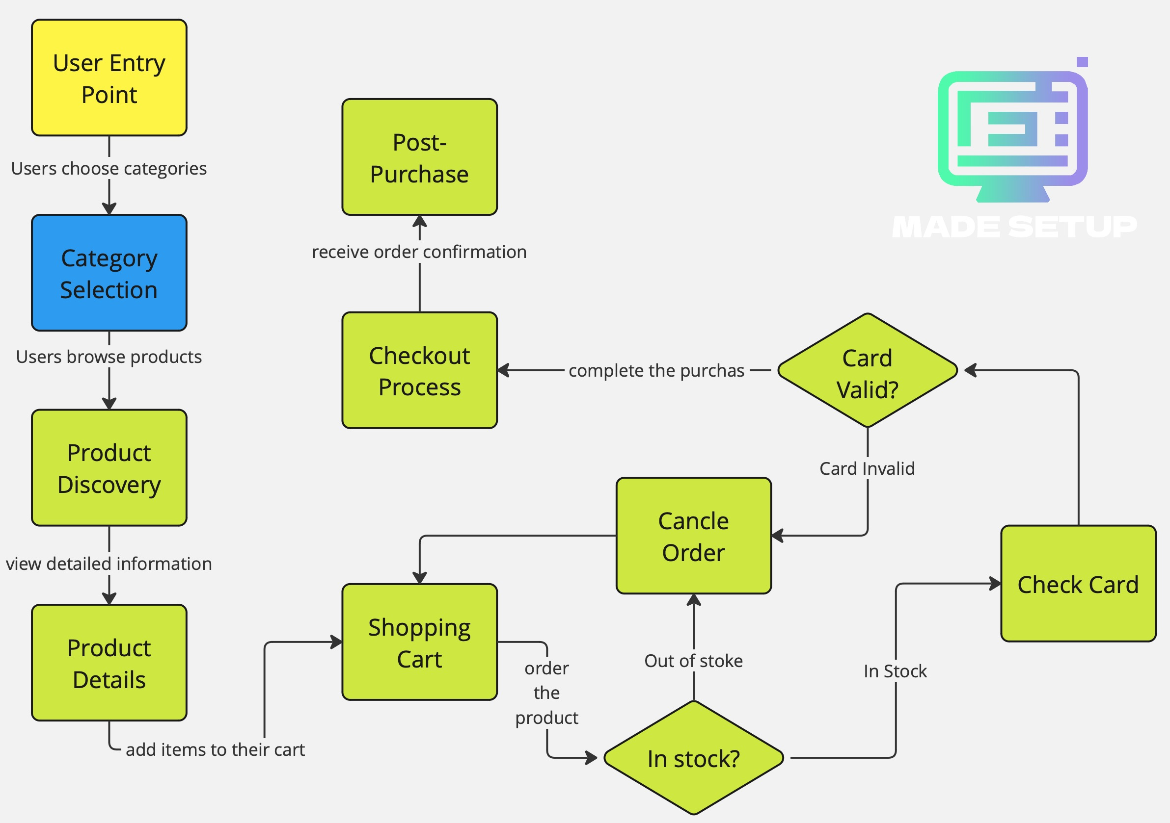
ER Diagram

Slide 7
Conclusion & Future Aspects
Conclusion:
Made Setup provides a comprehensive platform for users to purchase and customize setups, catering to diverse needs like gaming, designing, and office work.
With a focus on user experience, product variety, and competitive pricing, it stands out from competitors in the market.
Future Aspects:
Expansion of product categories to include more accessories and software solutions.
Integration of AI-based recommendations to offer personalized setups.
Introducing a subscription model for regular PC maintenance and updates.
Global shipping and partnerships with international suppliers.

Slide 8
Bibliography
W3Schools => HTML, CSS, and JavaScript Tutorials
Bootstrap Documentation => Bootstrap 5 Guide
MDN Web Docs => PHP and MySQL
SwiperJS Docs => Slider Integration
Google APIs => Maps and Payment Gateway Integration

Slide 9
Presentation Outline
Introduction to Project
Technology Used
Existing Gaps & Project Features
Objectives
Scope/Relevance
Project Flow Diagram
ER Diagrams
Test Cases
Comparative Analysis
Conclusion & Future Aspects
Bibliography

Slide 10
THANK YOU

